Slide 1

BRIDGING TRANSITION
Andrew McCormick MD
Journey to Adulthood

Slide 2
Objectives
Adding to the Tool Kit with Preparing and Planning

Slide 3
Outline
Review – Discovery & Tracking
Preparing and Planning – a Developmental Approach

Slide 4

Transition = Inclusion
Inclusion:
Person belongs to the group and uniqueness is valued
 | Valued | Devalued
Included | Inclusion | Assimilation
Excluded | Differentiation | Exclusion

Slide 5

Transfer Jump
Transfer Leap

Slide 6
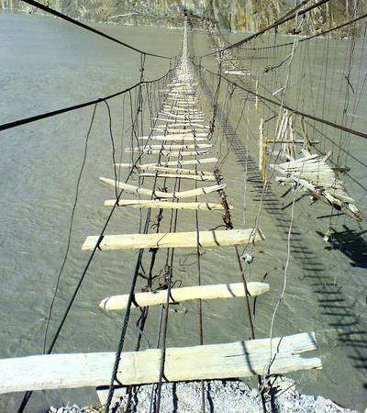
Gaps in Transition

Slide 7


Longitudinal Transition

Slide 8

Holistic Transition
legal
health
finance
employment
community

Slide 9
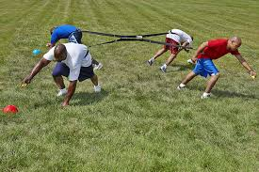
Transition Tug-of-war

Slide 10
Age/ Time | Provider | Parents | Youth | Adult Provider
Early | Has major responsibility | Caretaker | Receives care | Aware
Middle | Provides support to parent/youth | Manager | Participates | Aware + set goal for transfer
Late | Consultant | Supervisor | Manages | ↑ communication summary
Adult | Resource | Consultant | Supervisor/ CEO | Partnership in care
From: Good2Go and Bev Kosmach

Slide 11
Transition Bridge

Slide 12
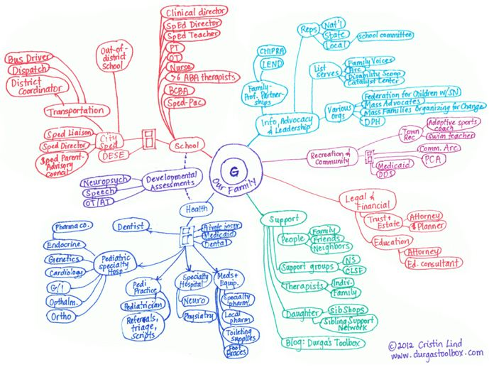

Slide 13
Transition Bridge

Slide 14
TOOL KIT
Transition Visits
Checklist
Readiness Assessment
Transfer Gear
Graduation Packet

Slide 15
Transition Visits
Build Your Team (Physician/Coordinator)
Individual Transition Plan
Assess Progress / Readiness
Create Goals
Start Your BINDER
Notes:
So, the transition visit is going to look very different for each family based on what resources are available. In Pittsburgh, we have a transition clinic where I spend 2 hours with every adolescent every year from 14 years of age until they are ready to launch between 18-21 years of age. Some people in this room may have similar options but probably many of you will not have transition specific care but will have a Down syndrome center or a primary care physician. Our goal is that even if your provider has no experience in transition, we want to give you the tools to make the process successful. First you need to build your team. You will need to pick your point of contact physician and a coordinator. Now the physician can be your PCP or a doctor at your DSC. The with the coordinator we sometimes need to be a little more creative. If your clinic has someone in this role then that is great but most clinics will not have a transition coordinator. But the good news is you can find a Social Worker who can fill this role. This may mean a little online research but there are more social workers specialized in this domain then anyone else.

Slide 16
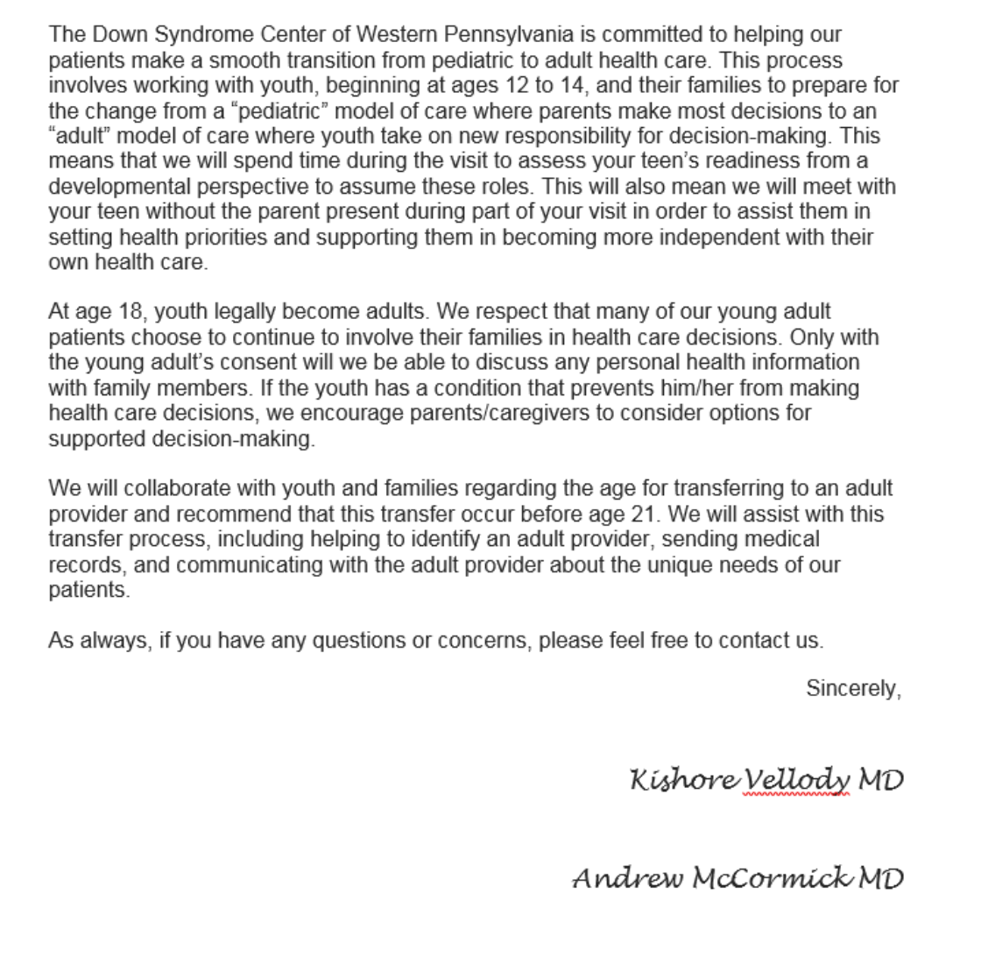
BUILD Your Team
Ask about Transition Policy
Discuss What Transition Resources are available
Come Prepared (Checklist, Readiness Assessments, Portable Medical Summary Template)
Make sure you doctor talks alone to your young adult

Slide 17
Transition Visits
Build Your Team (Physician/Coordinator)
Individual Transition Plan
Assess Progress / Readiness
Create Goals
Start Your BINDER
Notes:
So, the transition visit is going to look very different for each family based on what resources are available. In Pittsburgh, we have a transition clinic where I spend 2 hours with every adolescent every year from 14 years of age until they are ready to launch between 18-21 years of age. Some people in this room may have similar options but probably many of you will not have transition specific care but will have a Down syndrome center or a primary care physician. Our goal is that even if your provider has no experience in transition, we want to give you the tools to make the process successful. First you need to build your team. You will need to pick your point of contact physician and a coordinator. Now the physician can be your PCP or a doctor at your DSC. The with the coordinator we sometimes need to be a little more creative. If your clinic has someone in this role then that is great but most clinics will not have a transition coordinator. But the good news is you can find a Social Worker who can fill this role. This may mean a little online research but there are more social workers specialized in this domain then anyone else.

Slide 18
Transition Bridge

Slide 19
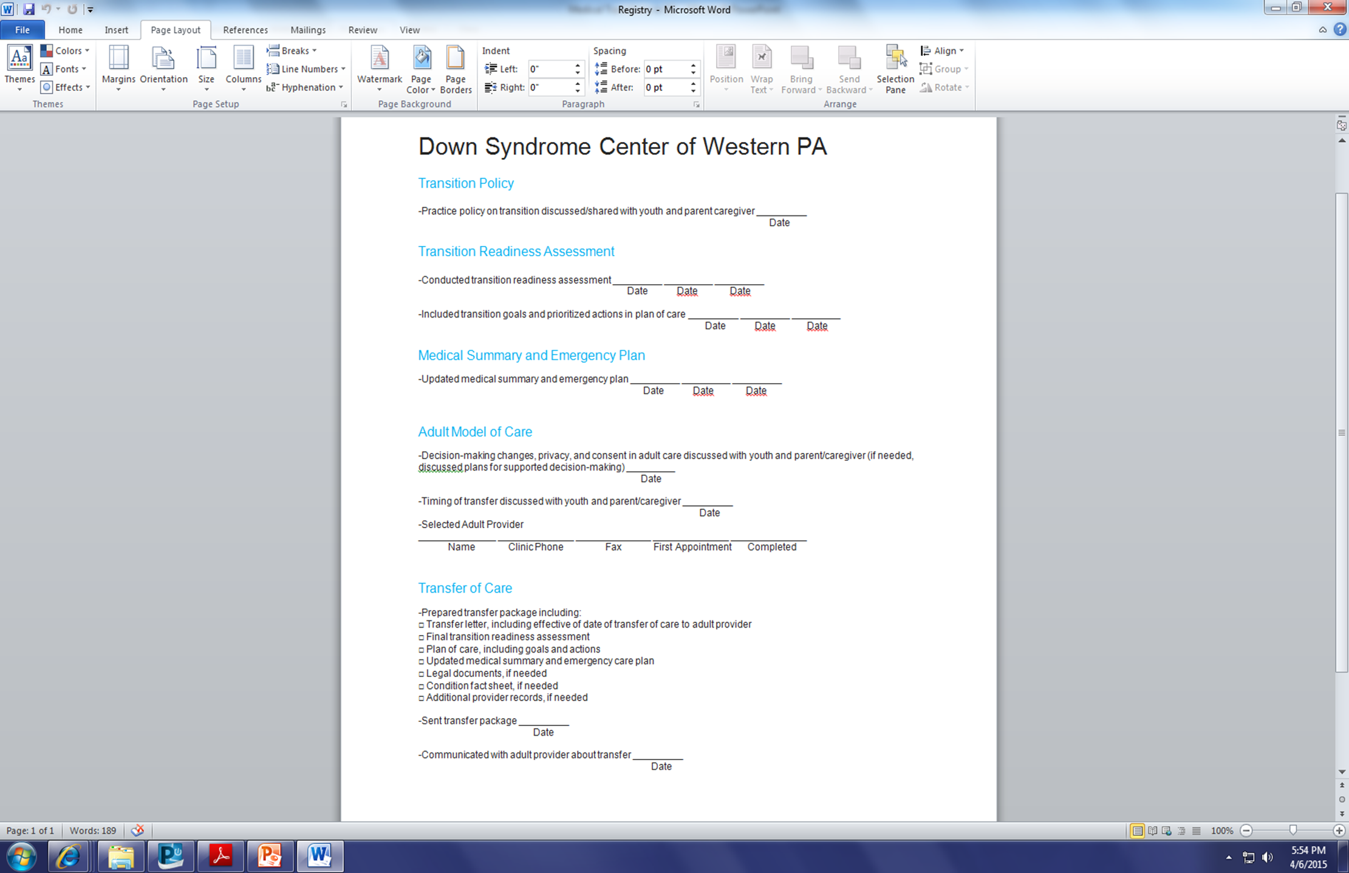
Notes:
This is an example of our healthcare transition check list. You have this in your packet as a reference but want to walk you through it to understand how this can be a helpful tool for your transition team. The first item is the transition policy, you need to make sure you understand and come to an agreement with your provider, on the when and how your will decide when the launch day will occur. The transition policy is the ground work agreement between you and your provider. Our transition policy states that we will be meeting with you and your young adult every year starting at 12-14 years of age until we determine that they have attained the necessary skills of transition with a goal launch between 18 and 21 years of age. There is flexibility in that statement to allow for the unique circumstances of each family.

Slide 20
Holistic Transition
legal
health
finance
employment
community

Slide 21
Employment
14-15 years
IEP should include transition goals
Volunteer
Understand disability and need for accommodations
16-17 years
IEP should be specific to post-secondary and employment goals
Invite community resources to IEP
Explore work experiences
Start Resume
18-21 years
IEP should be about job placement, training and accommodations
Complete Resume
Apply for jobs

Slide 22
Financial
14-15 years
Set up Bank Account
Research Special Needs Trust and Able Accounts
16-17 years
Obtain State ID
18-21 years
Apply for SSI
Research and prepare to apply for SSI
Set up Trust
Research about health insurance
Manage bank account independently/interdependently
Research Health insurance
Appy for Waivers

Slide 23
Legal
14-15 years
Parents should have a will
16-17 years
Research Power of Attorney v Guardianship
18-21 years
Set up POA v guardianship
Talk with Special Needs Attorney
Apply to vote
Males register with selective service

Slide 24
Transition Visits
Build Your Team (Physician/Coordinator)
Individual Transition Plan
Assess Progress / Readiness
Create Goals
Start Your BINDER
Notes:
So, the transition visit is going to look very different for each family based on what resources are available. In Pittsburgh, we have a transition clinic where I spend 2 hours with every adolescent every year from 14 years of age until they are ready to launch between 18-21 years of age. Some people in this room may have similar options but probably many of you will not have transition specific care but will have a Down syndrome center or a primary care physician. Our goal is that even if your provider has no experience in transition, we want to give you the tools to make the process successful. First you need to build your team. You will need to pick your point of contact physician and a coordinator. Now the physician can be your PCP or a doctor at your DSC. The with the coordinator we sometimes need to be a little more creative. If your clinic has someone in this role then that is great but most clinics will not have a transition coordinator. But the good news is you can find a Social Worker who can fill this role. This may mean a little online research but there are more social workers specialized in this domain then anyone else.

Slide 25
Transition Bridge

Slide 26
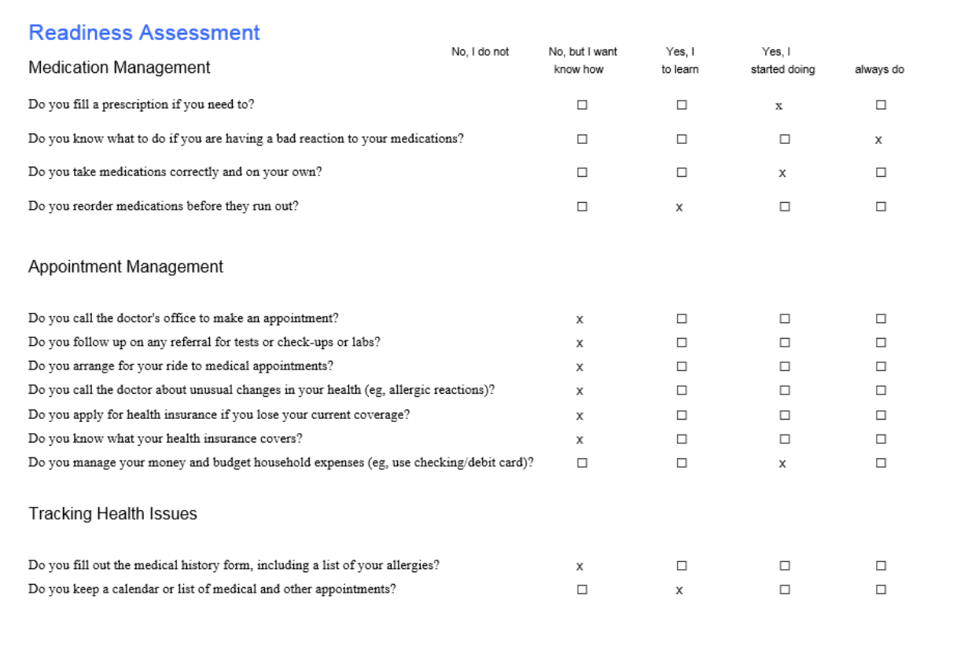

Slide 27
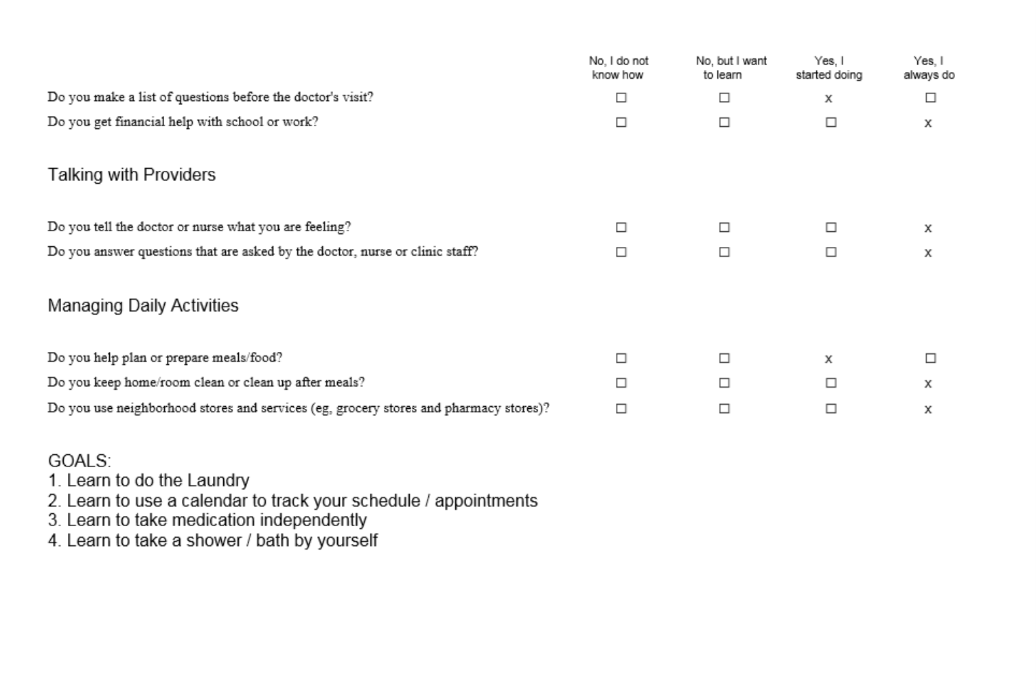

Slide 28
Transition Bridge

Slide 29
Transition Visits
Build Your Team (Physician/Coordinator)
Individual Transition Plan
Assess Progress / Readiness
Create Goals
Start Your BINDER
Notes:
So, the transition visit is going to look very different for each family based on what resources are available. In Pittsburgh, we have a transition clinic where I spend 2 hours with every adolescent every year from 14 years of age until they are ready to launch between 18-21 years of age. Some people in this room may have similar options but probably many of you will not have transition specific care but will have a Down syndrome center or a primary care physician. Our goal is that even if your provider has no experience in transition, we want to give you the tools to make the process successful. First you need to build your team. You will need to pick your point of contact physician and a coordinator. Now the physician can be your PCP or a doctor at your DSC. The with the coordinator we sometimes need to be a little more creative. If your clinic has someone in this role then that is great but most clinics will not have a transition coordinator. But the good news is you can find a Social Worker who can fill this role. This may mean a little online research but there are more social workers specialized in this domain then anyone else.

Slide 32
Operationalize Goal
Buy a Pill Tray
Start with learning to fill pill tray and take medication daily with supervision
Manage medication independently

Slide 36
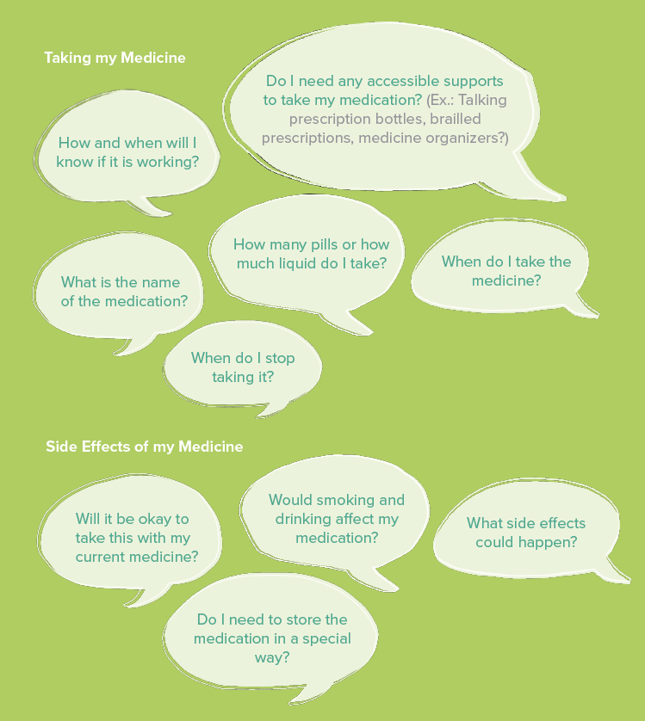

Slide 37

QUESTIONS
?

