Slide 1

BRIDGING TRANSITION
Andrew McCormick MD
Journey to Adulthood

Slide 2
Objectives
Starting building a Transition Bridge – Tracking PHASE

Slide 3
Outline
Review Care Maps – Discovery
Medical Tracking
Holistic Tracking

Slide 4

Transition = Inclusion
Inclusion:
Person belongs to the group and uniqueness is valued
 | Valued | Devalued
Included | Inclusion | Assimilation
Excluded | Differentiation | Exclusion

Slide 5

Transfer Jump
Transfer Leap

Slide 6

Gaps in Transition

Slide 7


Longitudinal Transition

Slide 8

Holistic Transition
legal
health
finance
employment
community

Slide 9
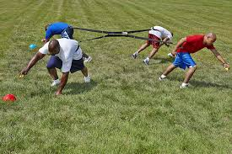
Transition Tug-of-war

Slide 10

Teen / Young perspective
Teens/Young Perspective:
Worry about facing the unknown
develop new trust relationship
uncertainty about maintaining self-care
Coyne et al. Journal of Clinical Nursing. 2019; 28:4062-4076
Notes:
Aim and objectives: To examine the needs and perspectives regarding healthcare transition for adolescents and young adults (AYAs) with the following long-term conditions: diabetes, cystic fibrosis and congenital heart disease.
Background: Transition of AYAs within healthcare services has become increasingly important as more children are surviving into adulthood with long-term conditions. Yet, limited empirical evidence exists regarding transition experiences.
Design: Qualitative study fulfilling the completed consolidated criteria for reporting qualitative studies criteria (see Appendix S1).
Methods: Semi-structured interviews with AYAs aged 14-25 years (n = 47), parents (n = 37) and health professionals (n = 32), which was part of a larger mixed-methods study. Sample was recruited from two children's hospitals and four general hospitals in Ireland.
Results: Transfer occurred between the ages of 16-early 20s years depending on the service. None of the hospitals had a transition policy, and transition practices varied considerably. Adolescents worried about facing the unknown, communicating and trusting new staff and self-management. The transition process was smooth for some young adults, while others experienced a very abrupt transfer. Parents desired greater involvement in the transition process with some perceiving a lack of recognition of the importance of their role. In paediatric services, nurses reported following-up adolescents who struggled with treatment adherence and clinic attendance, whereas after transfer, little effort was made to engage young adults if there were lapses in care, as this was generally considered the young adults' prerogative.
Conclusions: The amount of preparation and the degree to which the shift in responsibility had occurred prior to transition appeared to influence successful transition for AYAs and their parents.
Relevance to clinical practice: Nurses in collaboration with the multidisciplinary team can help AYAs develop their self-management skills and guide parents on how to relinquish responsibility gradually prior to transition.

Slide 11

Parent perspective
Parent Perspective
Desire greater involvement in process
Felt undervalued in transition process
"I’m not looking forward to moving because I’m out of the picture then, you know what I mean, I’m gone … I can't sit in with her, I can't ask questions..."
Coyne et al. Journal of Clinical Nursing. 2019; 28:4062-4076

Slide 12
Age/ Time | Provider | Parents | Youth | Adult Provider
Early | Has major responsibility | Caretaker | Receives care | Aware
Middle | Provides support to parent/youth | Manager | Participates | Aware + set goal for transfer
Late | Consultant | Supervisor | Manages | ↑ communication summary
Adult | Resource | Consultant | Supervisor/ CEO | Partnership in care
From: Good2Go and Bev Kosmach

Slide 13
Transition Bridge

Slide 14
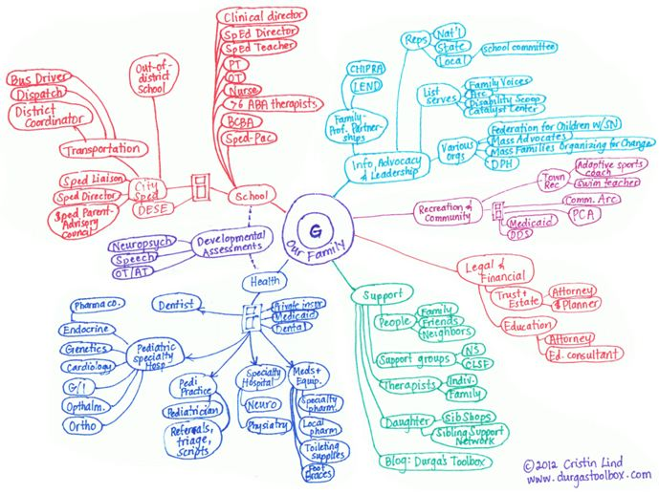

Slide 15
Transition Bridge

Slide 16
TOOL KIT
Transition Visits
Checklist
Readiness Assessment
Transfer Gear
Graduation Packet

Slide 17
Transition Visits
Build Your Team (Physician/Coordinator)
Individual Transition Plan
Assess Progress / Readiness
Create Goals
Start Your BINDER
Notes:
So, the transition visit is going to look very different for each family based on what resources are available. In Pittsburgh, we have a transition clinic where I spend 2 hours with every adolescent every year from 14 years of age until they are ready to launch between 18-21 years of age. Some people in this room may have similar options but probably many of you will not have transition specific care but will have a Down syndrome center or a primary care physician. Our goal is that even if your provider has no experience in transition, we want to give you the tools to make the process successful. First you need to build your team. You will need to pick your point of contact physician and a coordinator. Now the physician can be your PCP or a doctor at your DSC. The with the coordinator we sometimes need to be a little more creative. If your clinic has someone in this role then that is great but most clinics will not have a transition coordinator. But the good news is you can find a Social Worker who can fill this role. This may mean a little online research but there are more social workers specialized in this domain then anyone else.

Slide 18
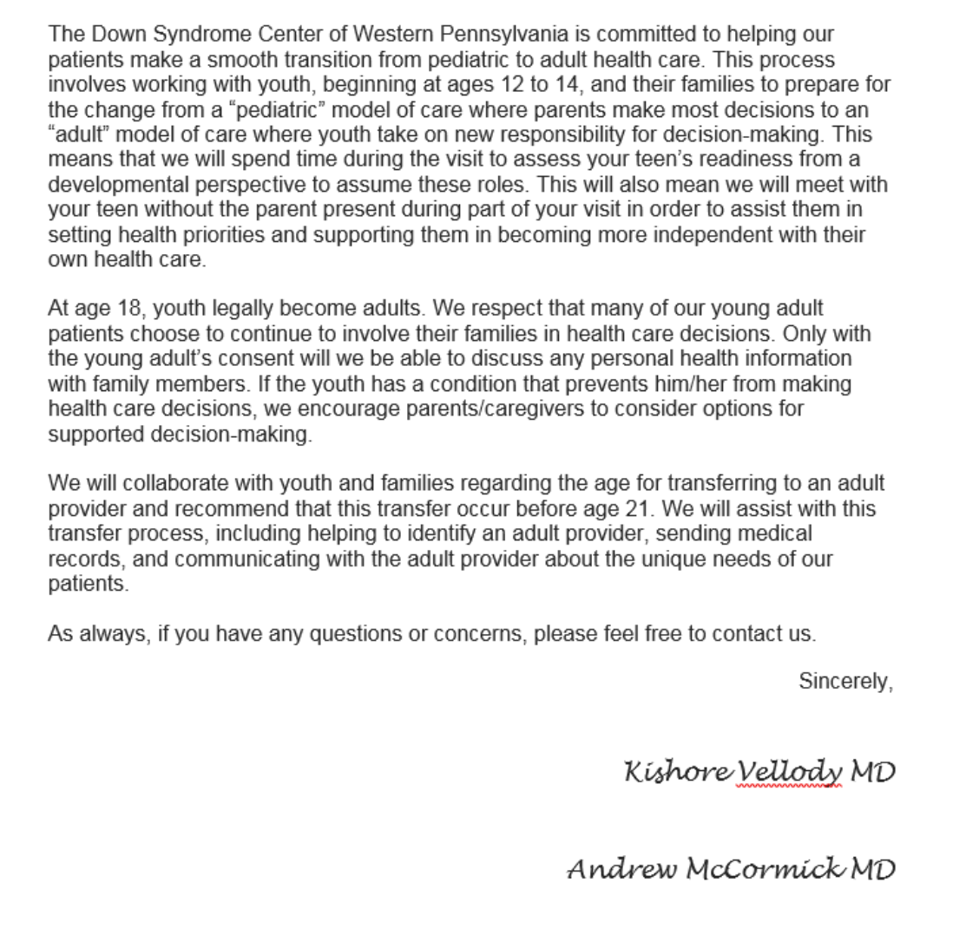
BUILD Your Team
Ask about Transition Policy
Discuss What Transition Resources are available
Come Prepared (Checklist, Readiness Assessments, Portable Medical Summary Template)
Make sure you doctor talks alone to your young adult

Slide 19
Transition Visits
Build Your Team (Physician/Coordinator)
Individual Transition Plan
Assess Progress / Readiness
Create Goals
Start Your BINDER
Notes:
So, the transition visit is going to look very different for each family based on what resources are available. In Pittsburgh, we have a transition clinic where I spend 2 hours with every adolescent every year from 14 years of age until they are ready to launch between 18-21 years of age. Some people in this room may have similar options but probably many of you will not have transition specific care but will have a Down syndrome center or a primary care physician. Our goal is that even if your provider has no experience in transition, we want to give you the tools to make the process successful. First you need to build your team. You will need to pick your point of contact physician and a coordinator. Now the physician can be your PCP or a doctor at your DSC. The with the coordinator we sometimes need to be a little more creative. If your clinic has someone in this role then that is great but most clinics will not have a transition coordinator. But the good news is you can find a Social Worker who can fill this role. This may mean a little online research but there are more social workers specialized in this domain then anyone else.

Slide 20
Transition Bridge

Slide 21
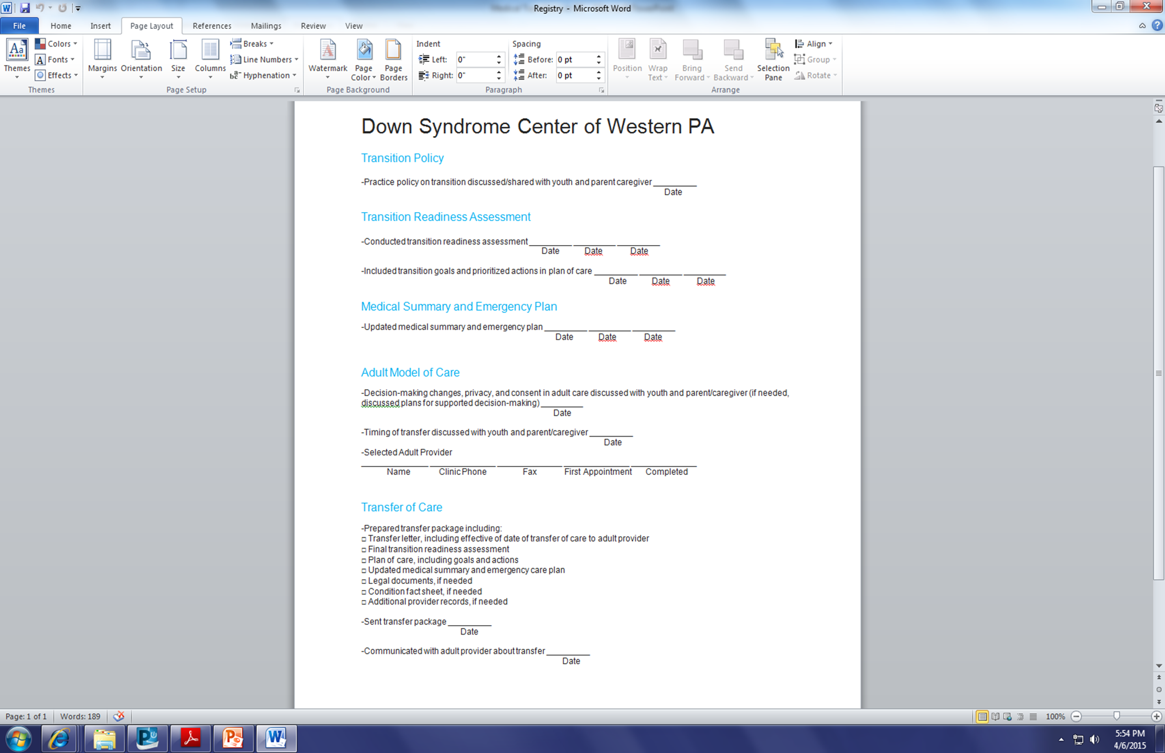
Notes:
This is an example of our healthcare transition check list. You have this in your packet as a reference but want to walk you through it to understand how this can be a helpful tool for your transition team. The first item is the transition policy, you need to make sure you understand and come to an agreement with your provider, on the when and how your will decide when the launch day will occur. The transition policy is the ground work agreement between you and your provider. Our transition policy states that we will be meeting with you and your young adult every year starting at 12-14 years of age until we determine that they have attained the necessary skills of transition with a goal launch between 18 and 21 years of age. There is flexibility in that statement to allow for the unique circumstances of each family.

Slide 22
Holistic Transition
legal
health
finance
employment
community

Slide 23

Education to Employment
80% children with intellectual disability graduate to unemployment

Slide 24
Education to Employment
Develop a vision for future
Build a team to support you
Access resources
Learn to be a self-advocate

Slide 25
Develop a Vision for your Future
Volunteerism is a First Key Step
  Try out career choices
  Learn the soft skills of the work place
  Build your resume

Slide 26

BUILD YOUR TEAM
Individual Education PLAN (IEP)
  Transition Planning starts at 14 years of age
  Designed to move a student from school to adult life: Based on the individual’s needs and taking into account strengths and vison of that student
  To include instruction in preparation for post-secondary education, employment assessment, development of employment, community experience, self-advocacy and daily living skills.

Slide 27

Build Your Team
Who’s on the IEP Team?
The Student
Parents/Guardians
Teacher and Support Staff
  Transition Coordinator
  Special Education Director
  Social Worker / Therapist
Office of Vocational Rehabilitation Counselor / Supports Coordinator

Slide 28
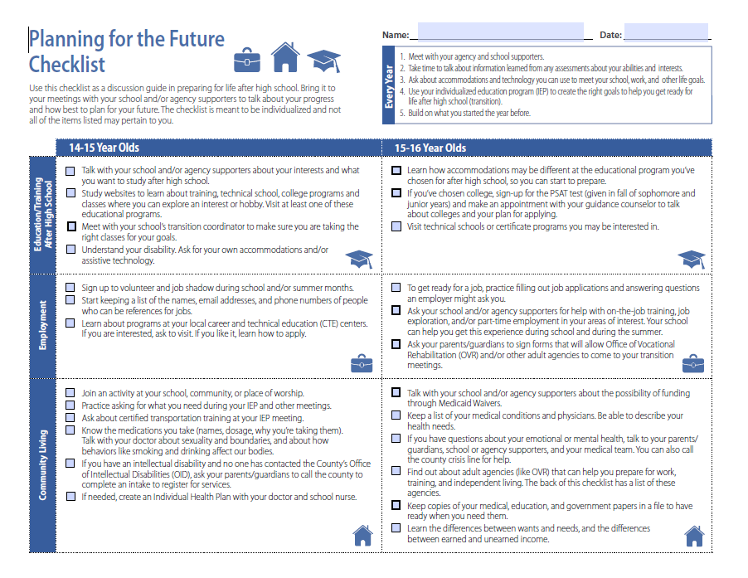

Slide 29
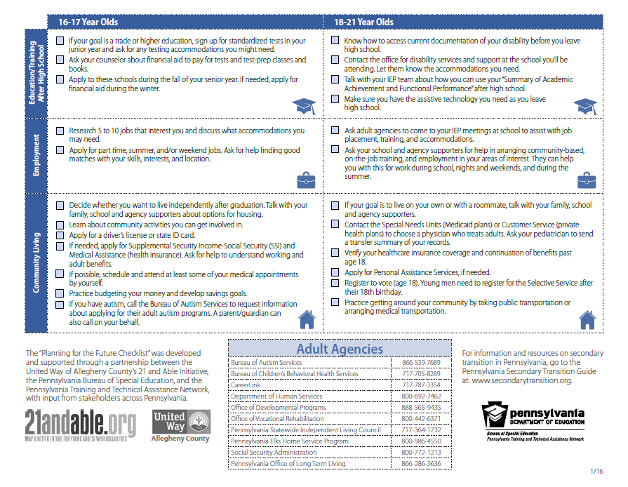

Slide 30

Access Resources
Job Training
Office of Vocational Rehabilitation
Post-Secondary Program
www.thinkcollege.net
Last 2 yrs of HS
Employed
90 DAYS
14yr and 9th grade
Ready to
Work
Individual Services
IPE:
INDIVIDUAL PLAN FOR EMPLOYMENT
Group Services

Slide 31


Self-Advocacy
CHANGE
  Children’s Hospital’s Advisory Network for Guidance and Empowerment
PA Youth Leadership Network

Slide 32
Employment
14-15 years
IEP should include transition goals
Volunteer
Understand disability and need for accommodations
16-17 years
IEP should be specific to post-secondary and employment goals
Invite community resources to IEP
Explore work experiences
Start Resume
18-21 years
IEP should be about job placement, training and accommodations
Complete Resume
Apply for jobs

Slide 33

Bridging the Financial Gap
Supplemental Security Income
Social Security Disability Income
Special Needs Trusts / ABLE Act
Waivers

Slide 34
Supplemental Security Income
After 18 years of age:
Based on Function
Based on Individuals Income
Before 18 years of age:
Based on Diagnosis
Based on Parents Income

Slide 35
Supplemental Security Income
YOU MUST REAPPLY, DOES NOT ROLLOVER
1
Make sure you are considering FUNCTION
2
People with intellectual disability will need IQ testing
Based on individual’s income
3
Resource Limit of $2000
Excluded in resource count are home, car, and trusts

Slide 36
Supplemental Security Income
BENEFITS
Cap $750/month benefit for individuals
Linked to Medicaid Benefit
Eligible for Waivers

Slide 37
Financial Benefit of WORKING

Slide 38
Social Security Disability Income
Eligibility:
  Adequate work history (40 quarters) and chronic/permanent disability
  Parent with adequate work history who
    Becomes Disabled
    Dies
    Retires

Slide 39

Social Security Disability Income
Based on wage earner’s contributions and number of dependents drawing from work history
Linked to Medicare

Slide 40
TRUST FUNDS
POOLED TRUST
Administered by non-profit organization
At death, money stays in trust
PAYBACK TRUST
Administered privately
At death, payback Medicaid benefits but then disperse remainder to designated beneficiaries
THIRD PARTY
Administered by third party and not individual
At death, distributed to family

Slide 41
ABLE ACCOUNTS
state-offered program that gives individuals with qualifying disabilities a tax-advantaged way to save or invest without impacting their government benefits
No initiation fee, maintenance fee $45/yr
Annual max contribution $15,000.00
Save up to $100,000.00 before counting as a resource toward SSI benefits
No taxation on money paid towards qualifying expenses
PAABLE.gov

Slide 42
Waivers
Federal government “waives” Medical Assistance/Medicaid rules for funds that pay for care services in the community that allow an individual to avoid institutionalization.

Slide 43
Consolidated Waiver
designed to help individuals with an intellectual disability, autism or developmental disability to live more independently in their homes and communities and to provide a variety of services that promote community living, including self-directed service models and traditional, agency-based service models.

Slide 44
Consolidated Waiver
Shift Nursing
Small Group Employment
Specialized Supplies
Supported Employment
Supported Living
Supports Broker
Supports Coordination
Therapy
Transportation
Vehicle Accessibility Adaptations
Advanced Supported Employment
Assistive Technology
Behavioral Support
Family/Caregiver Training and Support
Home Accessibility Adaptations
Homemaker/Chore
Housing Transition and Tenancy Sustaining Services
In-Home and Community Support
(Licensed and Unlicensed) Life Sharing
Music, Art and Equine Assisted Therapy
(Licensed and Unlicensed) Residential Habilitation
Respite
Community Participation Support
Companion
Consultative Nutritional Services
Education Support

Slide 45
Financial
14-15 years
Set up Bank Account
Research Special Needs Trust and Able Accounts
16-17 years
Obtain State ID
18-21 years
Apply for SSI
Research and prepare to apply for SSI
Set up Trust
Research about health insurance
Manage bank account independently/interdependently
Research Health insurance
Appy for Waivers

Slide 46

Legal Transitions
Power of Attorney vs. Guardianship
Decision Making Capacity

Slide 47
Decision Making Capacity
CAPACITY:
An adult’s ability to receive and evaluate information effectively and communicate decision

Slide 48
Power of Attorney
Shared Decision Making Capacity
Health Care Power of Attorney:
Allows an individual to name an agent who can act on his or her behalf to make medical decisions for the individual in the in event the individual cannot.
Authorize Treatment
Withdrawing Treatment
Implementing a DNR
Hiring medical professional/Support Staff
Admit or Discharge from the hospital
Admit or Discharge from a nursing home
Access to Medical Record
Participate in Appointments

Slide 49
Power of Attorney
Healthcare Power of Attorney
Financial Power of Attorney
Durable Power of Attorney

Slide 50
Guardianship
An individual is determined to be incapacitated
Medical Evaluation / Court Review
Court appoints a agent to be decision maker for the individual
Costly
Invasive
Time consuming

Slide 51
Legal
14-15 years
Parents should have a will
16-17 years
Research Power of Attorney v Guardianship
18-21 years
Set up POA v guardianship
Talk with Special Needs Attorney
Apply to vote
Males register with selective service

Slide 52

QUESTIONS
?

