Slide 1
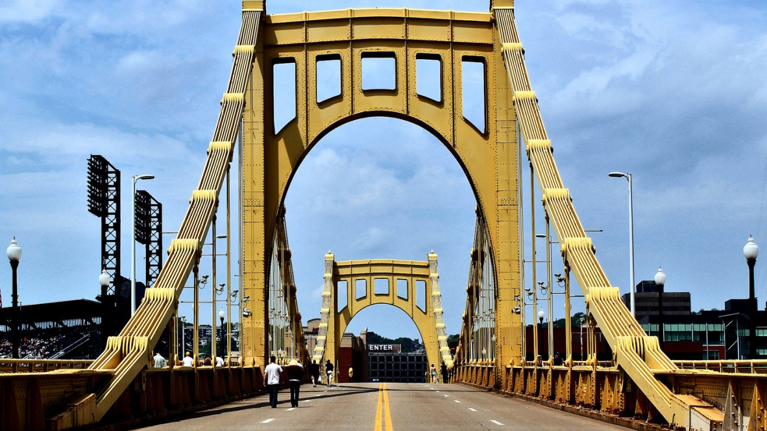
BRIDGING TRANSITION
Andrew McCormick MD
Journey to Adulthood

Slide 2
Objectives
Appreciate the importance of a holistic and longitudinal transition process
Develop a framework for successful transition

Slide 3
Outline
WHY – what is the purpose of transition?
Looks at GAP
Look at SOLUTIONS
Start with Discovery

Slide 4
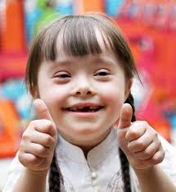
Model of Value
DISABILITY = DISEASE
Congenital Heart Disease
Duodenal Atresia
Developmental / Intellectual Disability
Behavioral Disorders

Slide 5
Model of Value
DISABILITY = DISEASE
Congenital Heart Disease
Duodenal Atresia
Developmental / Intellectual Disability
Behavioral Disorders

Slide 6
Model of Value
DISABILITY = DIVERSITY
Employed
Healthy Relationships
Self Advocate
Living Interpedently / Interdependently

Slide 8
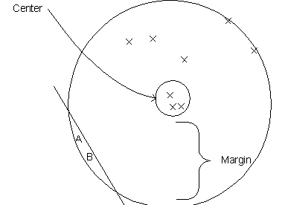

Slide 9
Model of Value
DISABILITY = DIVERSITY
Employed
Healthy Relationships
Self Advocate
Living Interpedently / Interdependently

Slide 10

Transition = Inclusion
Inclusion:
Person belongs to the group and uniqueness is valued
 | Valued | Devalued
Included | Inclusion | Assimilation
Excluded | Differentiation | Exclusion

Slide 11

Transfer Jump
Transfer Leap

Slide 12
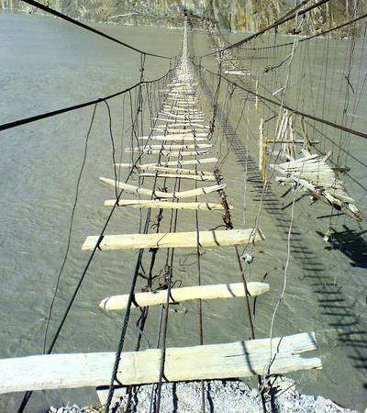
Gaps in Transition

Slide 13
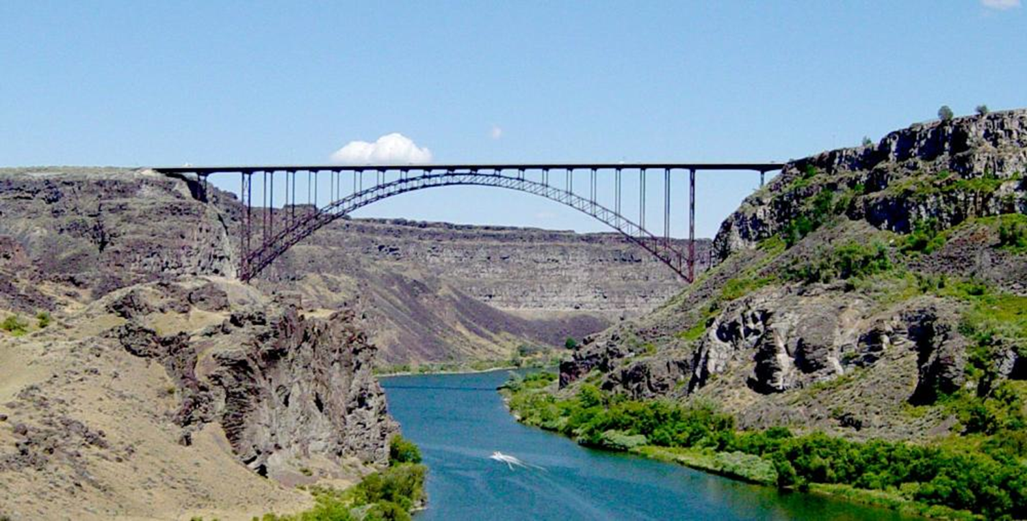
Bridging Transition

Slide 14

Longitudinal Transition

Slide 15
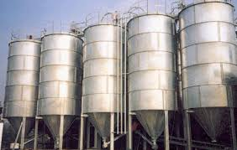
Silos of Care
E
M
P
L
O
Y
M
E
N
T
C
O
M
M
U
N
I
T
Y
FI
NANCE
H
E
A
L
T
H
LEGAL

Slide 16
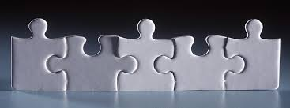
Holistic Transition
legal
health
finance
employment
community

Slide 17
Age/ Time | Provider | Parents | Youth | Adult Provider
Early | Has major responsibility | Caretaker | Receives care | Aware
Middle | Provides support to parent/youth | Manager | Participates | Aware + set goal for transfer
Late | Consultant | Supervisor | Manages | ↑ communication summary
Adult | Resource | Consultant | Supervisor/ CEO | Partnership in care
From: Good2Go and Bev Kosmach

Slide 18
Transition Bridge

Slide 19
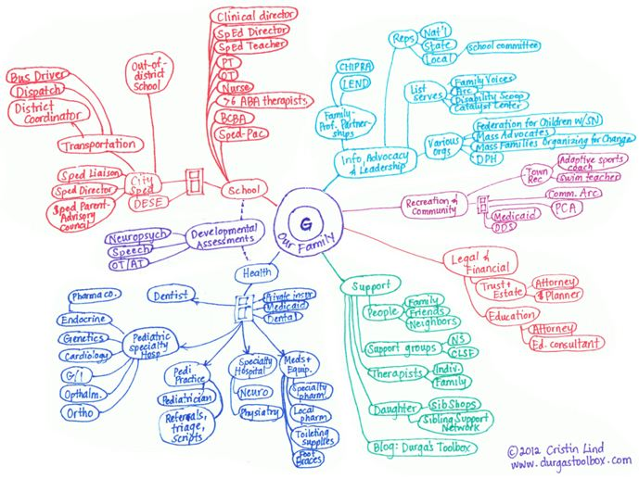

Slide 20
Transition DOMAINS
legal
health
finance
employment
community

Slide 21
Transition DOMAINS
What are the institutions?
Who are the people?
What are the resources?
legal
health
finance
employment
community

Slide 22
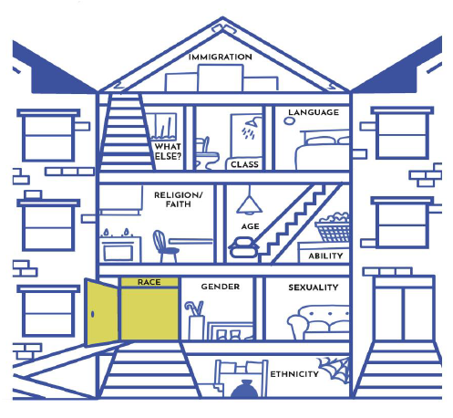
INTERSECTIONALITY

Slide 23
Intersectionality
In each Domain, which three rooms in this house are you conscious most? Least?

Slide 24
mccormickaa@upmc.edu

Slide 25
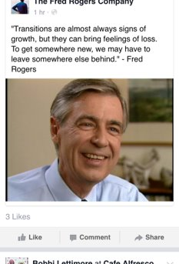
QUESTIONS
?

